Slide 1
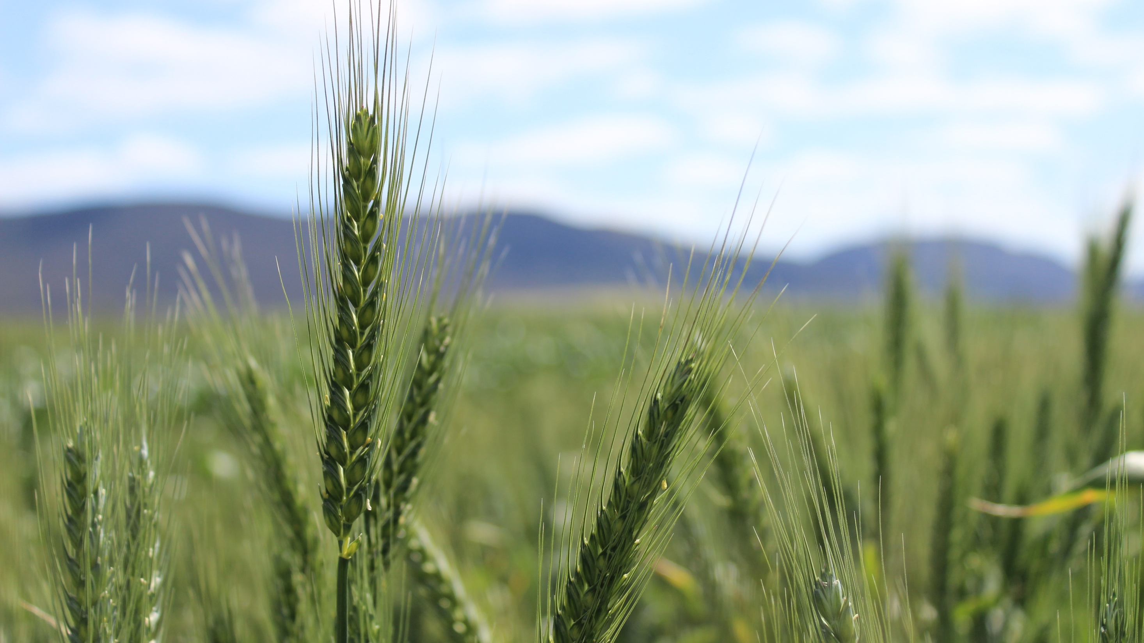


New wheat & barley varieties
Rob Harris
Marketing & Production Manager - Victoria
September 2021

Slide 2
Calibre (RAC2721)
Derived from popular variety Scepter
Quick-mid maturity, similar to Mace
Very widely adapted, suited to most growing regions of SA/VIC
Good sprouting tolerance, similar to Scepter
Longer coleoptile than most commonly grown varieties
Improved powdery mildew and stripe rust resistance over Scepter
AH quality classification
2021 Provisional NVT disease ratings
Stem Rust | RMR
Stripe Rust | MS
Leaf Rust | S
Yellow Leaf Spot | MS
Septoria Tritici Blotch | S
Powdery Mildew | S
CCN | MRMS
Black Point | MS

Slide 3
Boree (V09063-47-16)
Elite yielding APH quality (S NSW Zone) variety for main season sowing
Mid season maturity, similar to Beckom and Scepter
Broadly adapted, suits a range of soil types and environments
Suitable for wheat-on-wheat rotations, with good yellow leaf spot resistance
Good lodging resistance
2021 Provisional NVT disease ratings
Stem Rust | MR
Stripe Rust | MRMS/S
Leaf Rust | S
Yellow Leaf Spot | MRMS
Septoria Tritici Blotch | S
Powdery Mildew | VS
CCN | -
Black Point | MS

Slide 4
Barley

Slide 5
Cyclops (AGTB0200)
high yielding barley for low to medium rainfall environments
Quick-mid maturity, slightly slower than Spartacus CL
Wide adaptation to a range of environments and seasonal conditions
Erect growing Hindmarsh plant type
Less susceptible to lodging than taller varieties such as Compass
Competitive physical grain quality package
Has entered the Barley Australia malt accreditation program but is currently deliverable as Barley/Feed
2021 Provisional NVT disease ratings
Scald | SVS
Leaf Rust | SVSp
SFNB | S
NFNB | MSp
Powdery Mildew | MSp
CCN | S

Slide 6
Minotaur (AGTB0213)
A lower risk alternative to RGT Planet
Best suited to medium to higher rainfall environments
Mid-slow maturity, slightly slower than RGT Planet
Broader adaptation than RGT Planet, delivering more stable yields across a wider range of environmental conditions
Improved test weight compared with RGT Planet
Has entered malt accreditation program but is currently deliverable as Barley/Feed
2021 Provisional NVT disease ratings
Scald | SVS
Leaf Rust | SVS
SFNB | S
NFNB | MSp
Powdery Mildew | Sp
CCN | R

Slide 7
Further Information
NVT Website to see how well these varieties have performed last season
Boree, Minotaur and Cyclops are present in ICC variety trials this season: results will be available to members after harvest
Check out the AGT Website for Fact Sheets on all our new releases https://www.agtbreeding.com.au/varieties
On our website you can also find details on how to source seed of our varieties
Please don’t hesitate to contact me if you have any questions

